Slide 3
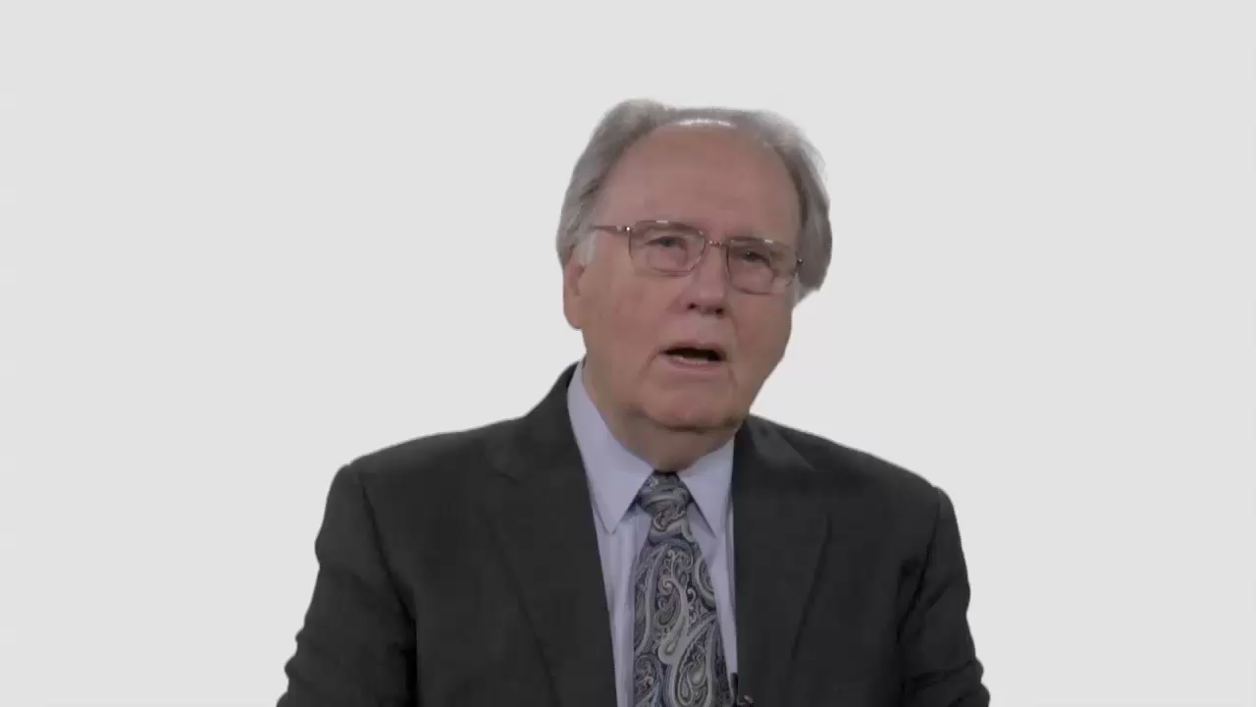

Slide 4
Have Your Say.
What are some of the biggest
“trust killers” in the ways older
and younger people in the church speak and act toward each other?

Slide 5
Conversation Builders.
In your congregation, what are
the major differences between
the young and the not-so-young?

Slide 6
Conversation Builders.
What do teenagers and older
members share in common in
terms of beliefs, hopes for the
church, and vision for mission?

Slide 7
Discussion Questions.
How much emphasis should be
placed on experience when filling elected positions within your church?

Slide 8
Discussion Questions.
Could young people be partly
to blame when they’re sidelined
from church office?

Slide 9
Discussion Questions.
What do older people in this congregation need to do or say
to make younger members feel
loved, heard, and trusted?

Slide 10
Discussion Questions.
How can younger people
help the older ones feel
respected and valued?

Slide 11
What Now?
What are two or three practical,
easily implemented ideas for
improving the intergenerational
lines of communication
within your congregation?

